Slide 1

Combating Voyeurism with AI
CC0007 T11 Cluster C Group 30
Jerome Wang, Lim Dong Wan, Ng Hui Yi, Ryan Tan, Le Anh Ngoc

Slide 2





Agenda
Problem Statement
Proposed Innovation
AI Architecture
COST-Benefit Analysis
Concluding Thoughts

Slide 3
Problem Statement
Agenda
The increase in voyeurism cases has yet to be stymied by effective control measures.
Problem Statement
Proposed Innovation
AI Architecture
COST-Benefit Analysis
Concluding Thoughts

Slide 4
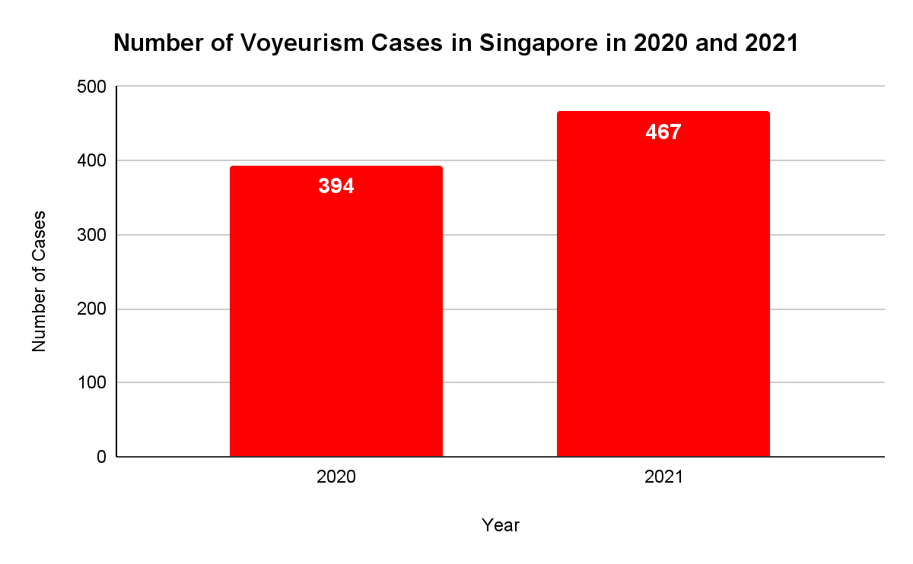
Problem Statement
The increase in voyeurism cases has yet to be stymied by effective control measures.
(Sun, 2022)

Slide 5
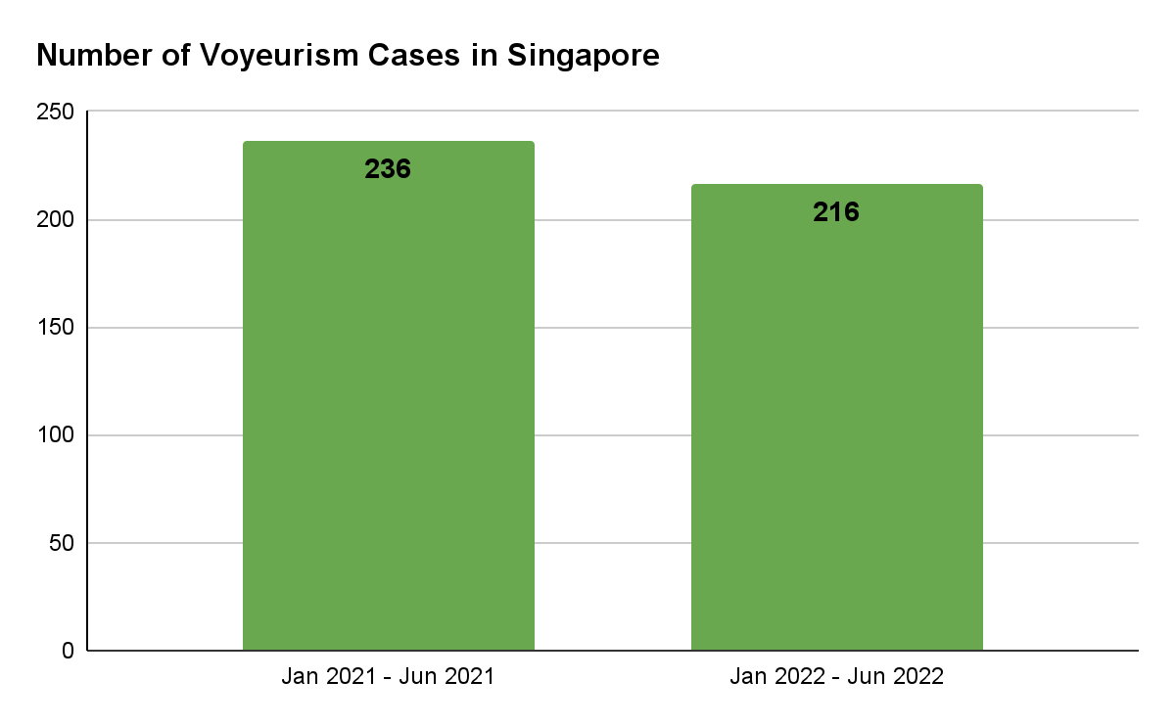
Problem Statement
Decrease in cases after parliament passing is insignificant.
(SPF, 2022)

Slide 6


Target Audience
Policymakers
Law Enforcement Agencies

Slide 7


Proposed Innovation
SAFESECURE
Computer Vision AI system to detect and flag likely voyeuristic actions
Frames from CCTV video streams
Timestamps & Pixel Coordinates of flagged actions

Slide 8
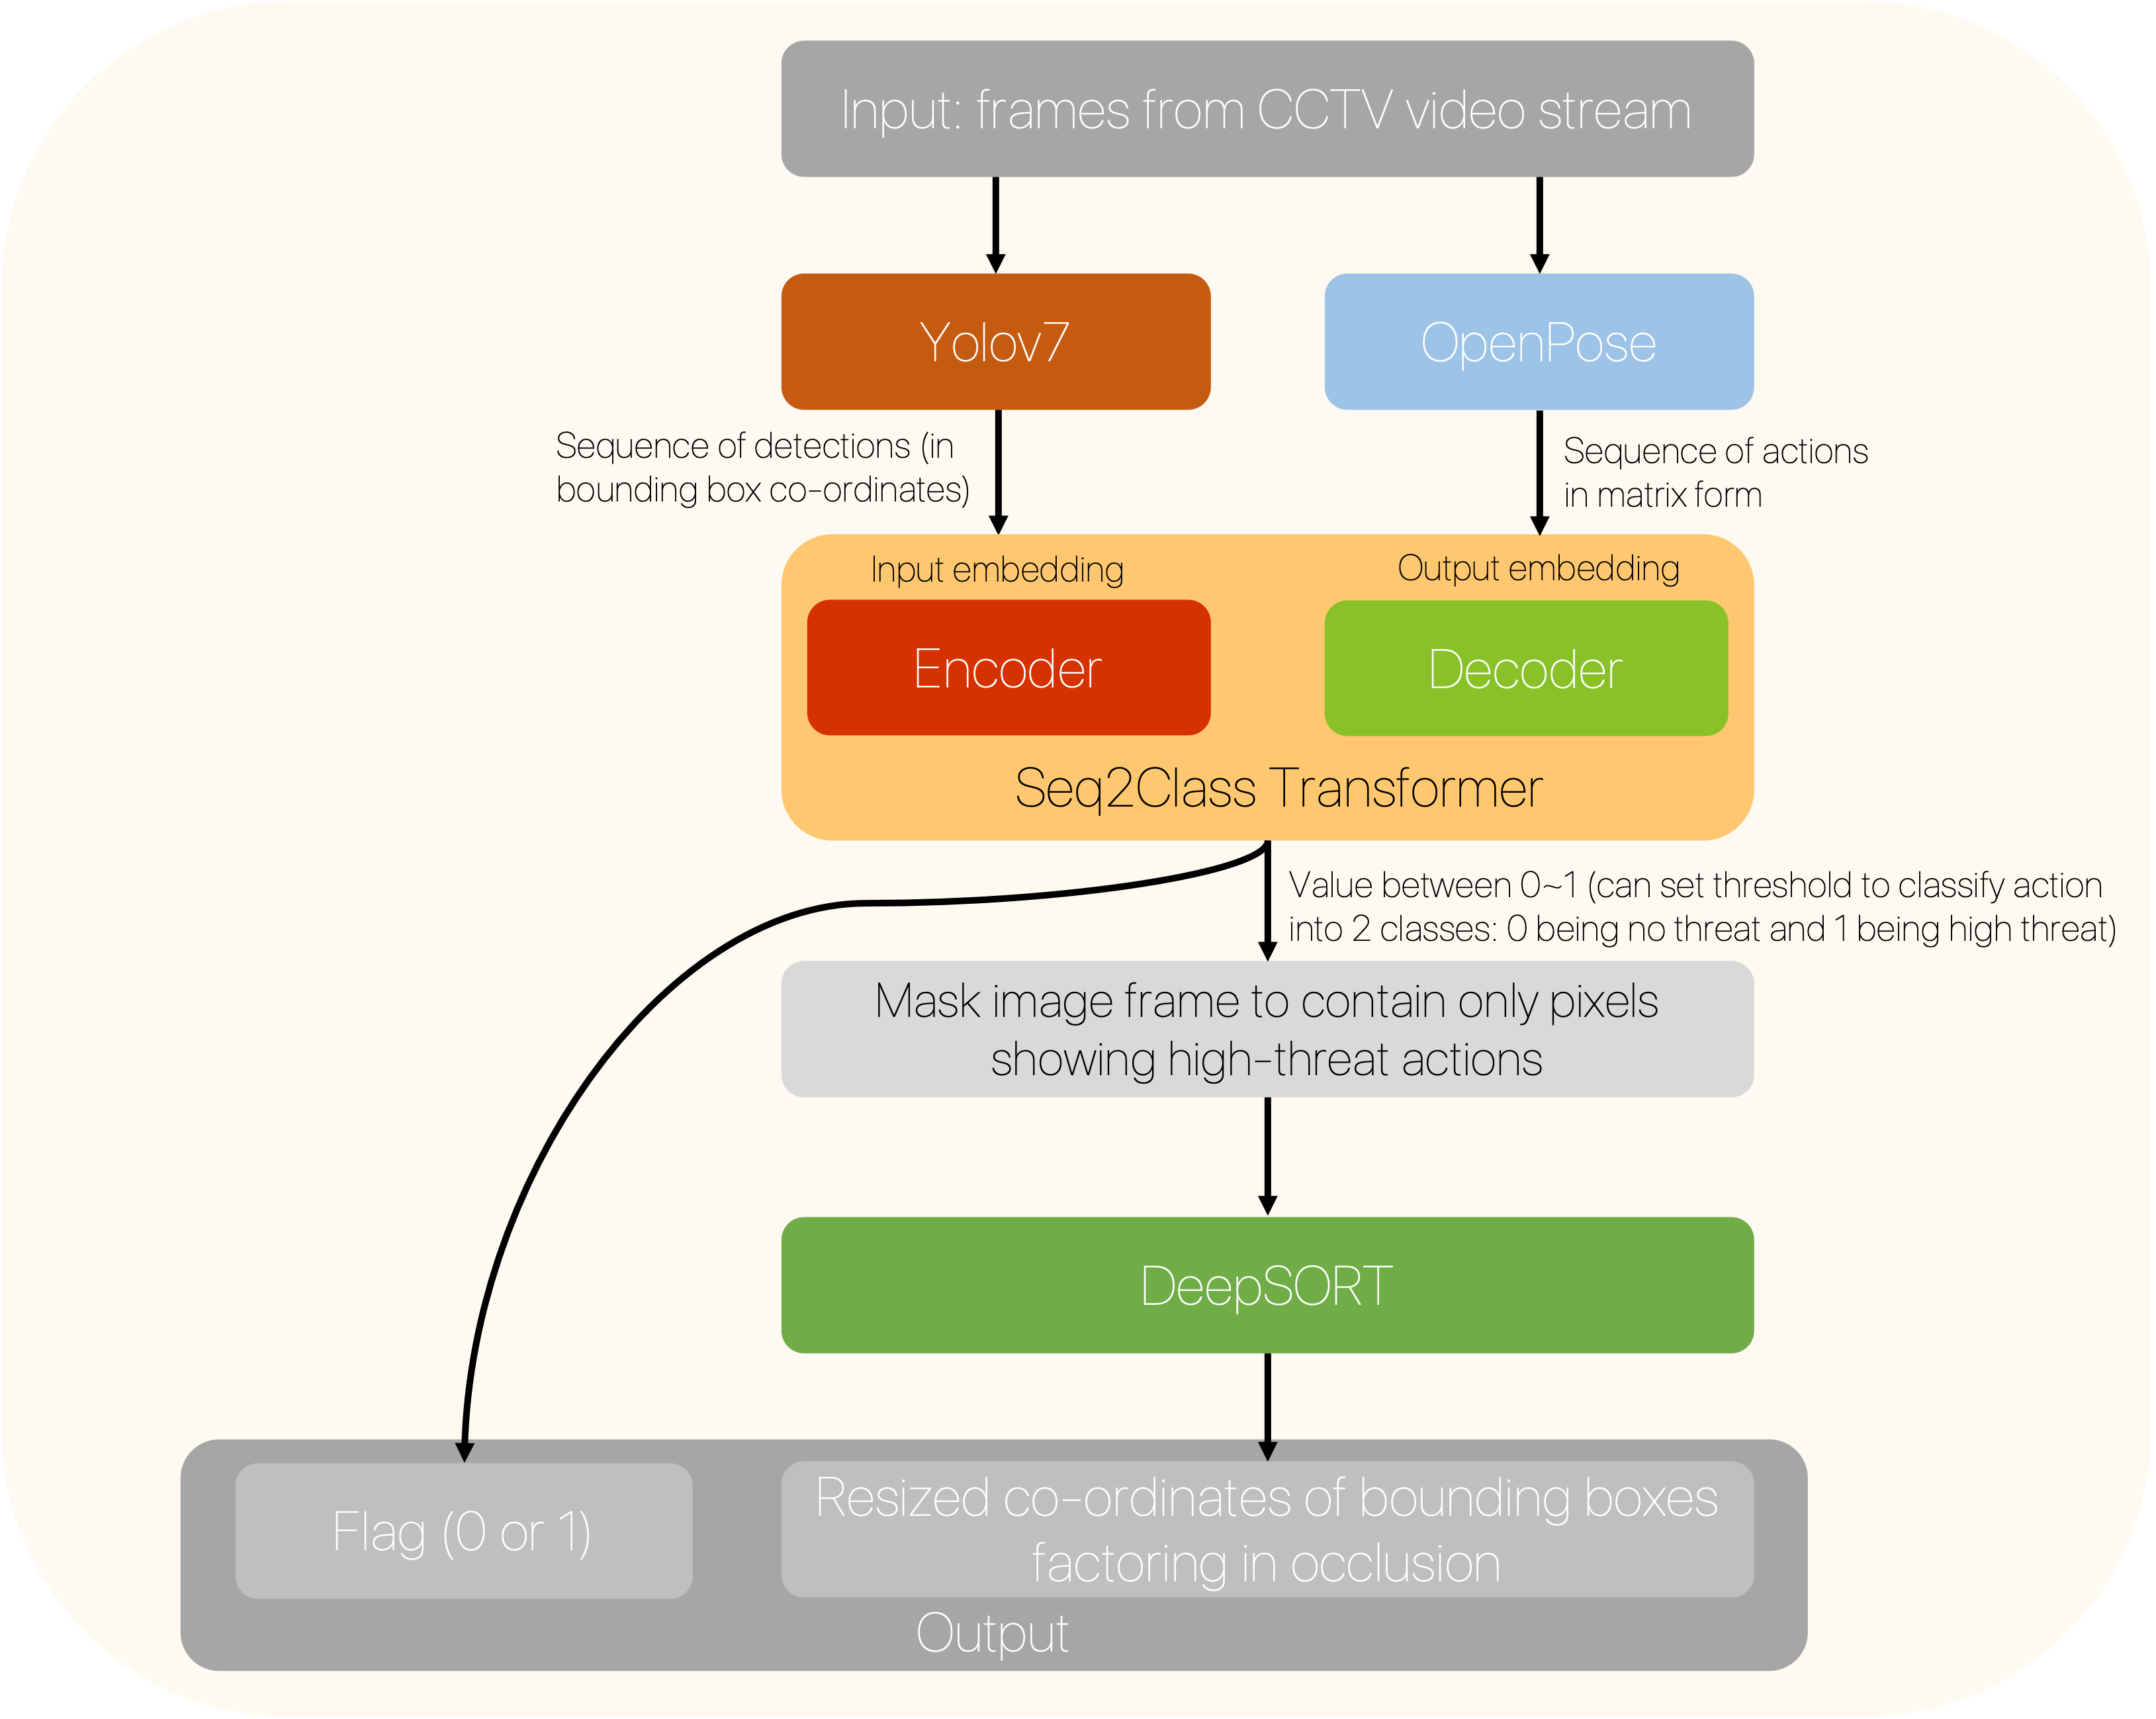
Proposed Innovation

Slide 9



Features
Analyse Threats & Identify Suspects
Enhanced Policing Capabilities
Sensitive to minute Movements

Slide 10


Features
Deterrence for voyeurism
Offender will not escape unpunished
Analyse Threats & Identify Suspects
Enhanced Policing Capabilities
Sensitive to minute Movements

Slide 11
Features
Deterrence for voyeurism
Lead time to Arrest
Offender will not escape unpunished
Effectiveness of resources
Enhanced Policing Capabilities
Analyse Threats & Identify Suspects

Slide 12
Features
Crucial in determining suspect’s motive
Lead time to Arrest
Picks up visual cues that even humans may miss
Effectiveness of resources
Enhanced Policing Capabilities
Sensitive to minute Movements

Slide 13

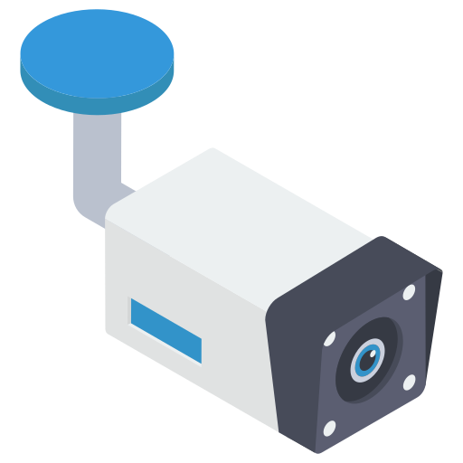
Feasibility
Cameras have been used to solve over 5,000 criminal cases.
Crucial in determining suspect’s motive
Picks up visual cues that even humans may miss
Blind spots are rare and are set to decrease as 200,000 PolCams are installed by 2030
Sensitive to minute Movements
Using cctv video feed for Detection
(CNA, 2021)

Slide 14

Feasibility
Cameras have been used to solve over 5,000 criminal cases.
Transformer network draws global dependencies
Blind spots are rare and are set to decrease as 200,000 PolCams are installed by 2030
Using cctv video feed for Detection
Sensitivity to minute Movements
(Vaswani, 2017)
(CNA, 2021)

Slide 15

Feasibility
Cost Benefit Analysis
Benefit
Transformer network draws global dependencies
Cost
Sensitivity to minute Movements
(Vaswani, 2017)

Slide 16

Cost
Expensive to train and implement AI models

Slide 17

Cost
Invasion of Privacy
Priv
acy

Slide 18

Benefit
24/7 COVERAGE LEADS TO
LOW
MISS RATE

Slide 19

Benefit
Enhances Victim Support in Arrests

Slide 20

Benefit
Safer Society

Slide 21


Concluding Thoughts
Governmental Support Needed
Strengthened Sense of Security

Slide 23
References
Chua, K. H. (n.d.). Tech in Asia - connecting Asia's startup ecosystem. Retrieved November 8, 2022, from https://www.techinasia.com/ai-facial-recognition-revolutionizing-physical-security-asia
CNA. (2021, October 10). Caught on camera: How 90,000 police cameras across Singapore help solve crimes. Retrieved November 6, 2022, from https://www.channelnewsasia.com/singapore/90000-police-cameras-surveillance-crimes-2230176
Ganapathy, A. (2020, December 1). The Crime of Voyeurism. IRB Law LLP. Retrieved November 5, 2022, from https://irblaw.com.sg/learning-centre/voyeurism/
James, G. (n.d.). Voyeurism in Singapore: Perspectives of a criminal defence lawyer. International Bar Association. Retrieved November 5, 2022, from https://www.ibanet.org/article/C2618FBC-D2BF-4E92-AF3C-71304062813D
MalayMail. (2022, October 20). In Singapore, serial voyeur jailed again for taking upskirt photos and videos of women riding escalators. Retrieved November 5, 2022, from https://www.malaymail.com/news/singapore/2022/10/20/in-singapore-serial-voyeur-jailed-again-for-taking-upskirt-photos-and-videos-of-women-riding-escalators/34643

Slide 24
References
Singapore Legal Advice. (2022, March 1). Crime of Voyeurism in Singapore. Retrieved November 5, 2022, from https://singaporelegaladvice.com/law-articles/crime-voyeurism-singapore-penalties-defences/
SPF. (2022). Police News Release - Mid-Year Crime Statistics 2022. Retrieved November 6, 2022, from https://www.police.gov.sg/-/media/90E8A6D32BBE4E838025817C160E40CA.ashx
Sun, D. (2022, February 28). Sex offenders to be dealt with more severely from March 1 under amended laws. The Straits Times. Retrieved November 5, 2022, fromhttps://www.straitstimes.com/singapore/sex-offenders-to-be-dealt-with-more-severely-from-march-1-under-amended-laws
Baheti, P. (2022, October 21). A Newbie-Friendly Guide to Transfer Learning. V7. Retrieved November 5, 2022, from https://www.v7labs.com/blog/transfer-learning-guide
Boesch, G. (2022, September 21). YOLOv7: The Most Powerful Object Detection Algorithm (2022 Guide). viso.ai. Retrieved November 5, 2022, from https://viso.ai/deep-learning/yolov7-guide/

Slide 25
References
Cao, Z., Hidalgo, G., Simon, T., Wei, S.E., Sheikh Y. (2019, May 30). OpenPose: Realtime Multi-Person 2D Pose Estimation using Part Affinity Fields. Retrieved November 5, 2022, from https://arxiv.org/pdf/1812.08008.pdf
Liu, X. (2021). A Spam Transformer Model for SMS Spam Detection. Retrieved November 5, 2022, from https://ruor.uottawa.ca/bitstream/10393/42057/3/Liu_Xiaoxu_2021_thesis.pdf
Nguyen, X.-B., Bui, D. T., Duong, C. N., Bui, T. D., & Luu, K. (2021). Clusformer: A transformer based clustering approach to unsupervised large-scale face and visual landmark recognition. 2021 IEEE/CVF Conference on Computer Vision and Pattern Recognition (CVPR). Retrieved November 5, 2022, from https://doi.org/10.1109/cvpr46437.2021.01070
Pereira, R., Carvalho, G., Garrote, L., Nunes, U.J. (2022, January 22). Sort and Deep-SORT Based Multi-Object Tracking for Mobile Robotics: Evaluation with New Data Association Metrics. MDPI. Retrieved November 8, 2022, from https://www.mdpi.com/2076-3417/12/3/1319/htm
Tewari, A. (2022, February 11). OpenPose Systems. OpenGenus IQ: Computing Expertise & Legacy. Retrieved November 5, 2022, from https://iq.opengenus.org/openpose-systems/

Slide 26
References
Tewari, A. (2022, February 11). OpenPose Systems. OpenGenus IQ: Computing Expertise & Legacy. Retrieved November 5, 2022, from https://iq.opengenus.org/openpose-systems/
Caught on camera: How 90,000 police cameras across Singapore Help Solve Crimes. CNA. (2021, October 10). Retrieved November 19, 2022, from https://www.channelnewsasia.com/singapore/90000-police-cameras-surveillance-crimes-2230176
Wakefield, J. (2021, May 25). AI emotion-detection software tested on Uyghurs. BBC News. Retrieved November 19, 2022, from https://www.bbc.com/news/technology-57101248
Klubnikin, A. (2022, August 29). How much does artificial intelligence cost in 2022? ITRex. Retrieved November 19, 2022, from https://itrexgroup.com/blog/how-much-does-artificial-intelligence-cost/
Radha B. (2016, January 19). Sexual crimes remain under radar in s'pore. The Straits Times. Retrieved November 19, 2022, from https://www.straitstimes.com/singapore/sexual-crimes-remain-under-radar-in-spore

Slide 27
References
International Bar Association. (n.d.). Voyeurism in Singapore: perspectives of a criminal defence lawyer. https://www.ibanet.org/article/C2618FBC-D2BF-4E92-AF3C-71304062813D
Deterrence source: CPNI (n.d.). Behavioural detection: Best practice, guidance, and advice. Retrieved November 19, 2022, from https://www.icao.int/Security/Security-Culture/Documents/UK%20-%20CPNI%20-%20Behavioural%20Detection%20Best%20Practice,%20Guidance%20and%20Advice%20Brochure.pdf

